Slide 1
What is Orchestrator?
Orchestrator is the component of UiPath Suite through which the automation workflows developed in Studio are published, assigned to robots and executed. It comes in the form of a web application that enables the management of robots, activity packages, data to be processed, execution schedules, as well as other assets.
Orchestrator is ideal for large deployments of robots covering complex processes, but it can also be deployed in scenarios dealing with short and repetitive processes and fewer robots.
What are Orchestrator's capabilities?
Provisioning - creates and maintains the connection with the robots.
Deployment - ensures the delivery of the workflows for execution, either immediately or using schedules.
Configuration - enables the creation, configuration and maintenance of groups of robots and the execution of tasks.
Queues - the data that needs to be processed is broken down to indivisible operations called transactions. Queues can store any number of transactions and they facilitate their distribution, execution and monitoring.
Monitoring - keeps track of robot identification data and maintains user permissions.
Logging - stores and indexes the logs to an SQL database and/or ElasticSearch.
Inter-connectivity - acts as the centralized point of communication for 3rd party solutions or applications, and can be used for storing activity packages, libraries and other assets (such as credentials).

Slide 2
What are the benefits of Orchestrator?
As you know, workflows can be executed on a local machine to perform simple tasks. In business contexts though, all the capabilities listed in the previous section are needed for effectively managing a large number of robots that have to execute numerous tasks. All these capabilities translate into tangible benefits, such as:
Accessibility and version control -Workflows can be published as packages and stored in Orchestrator, at version level and with the developer's release notes. Different versions can be distributed to robots for execution.
Transactional processing-Queues allow efficient allocation of the workload between robots, continuous execution and monitoring at transaction level.
Efficient planning and execution -Orchestrator allows execution of tasks according to schedules that can accommodate various scenarios (like non-working days)
Securely storing assets -Orchestrator provides a secure way of storing assets and distributing them to robots according to different scenarios
Monitoring- Robots, processes and task execution can be monitored via Orchestrator, which can enable quick reaction in case of any error, and also provides the means for accurate reporting and auditing of the robot work.

Slide 3
Orchestrator Key Concepts
Robot -The Robot is UiPath’s execution agent that enables you to run workflows built in Studio. It can be of several types.
Environment -An environment is a group of robots configured in Orchestrator. Processes can be allocated to individual robots, but it's more effective to allocate them to environments. A robot can be part of more than one environment, provided they are in the same service.
Package -A project developed in UiPath Studio that is published to Orchestrator. Multiple versions of the same project can be stored and used.
Process -It is a package that has been allocated to a certain environment.
Job -A job is a process that has been sent for execution to some or all of the robots in the environment.
Schedule -A process that is configured for an execution that is not immediate, but according to a schedule. Multiple configurations are possible when it comes to schedules.
Asset -An asset is a piece of data stored in Orchestrator for the use of robots. There are four types of assets:
Text - stores only strings (it is not required to add quotation marks);
Bool - supports true or false values;
Integer - stores only whole numbers;
Credential - contains usernames and passwords that the Robot requires to execute particular processes, such as login details for ERP systems.
Queue- A queue is a sequence of transactions that is built in Orchestrator, and then used to dispatch to robots for processing.

Slide 4
Robots and Environments in Orchestrator
The robot is UiPath’s execution agent that enables you to run workflows built in Studio. The installation of the Studio comes with a robot that is triggered when the 'Run' button is clicked when a project is open.
Provisioning robots in Orchestrator allows better package distribution capabilities, better scheduling, and enables the use of assets and queues. All these will take an implementation much closer to a business context.
Types of robots
Attended Robot-This type of Robot is triggered by user events, and operates alongside a human, on the same workstation. Attended Robots are used with Orchestrator for a centralized process deployment and logging medium.
Unattended Robot-Robots run unattended in virtual environments and execute any number of processes. On top of the Attended Robot capabilities, Orchestrator covers execution, monitoring, scheduling and providing support for work queues.
Development Robot-Has the features of an Unattended Robot, but it should be used only to connect Studio to Orchestrator, for development purposes.
Non-production robot-Similar to Unattended Robots, but they should be used only for development and testing purposes.

Slide 5
Standard and Floating Robot
Standard Robot-Works on a single Standard Machine only. It is a good choice when the machine on which the robot runs is known and will never change.
Floating Robot-Works on any machine defined in Orchestrator. It is a good choice when human users work in shifts on the same machine or on different machines, and when virtual machines are being regenerated often.

Slide 6
Provisioning robots in Orchestrator
In order for robots to perform jobs, they have to be provisioned in Orchestrator, together with the machines that they will be using.
Provisioning Robot:
navigated to platform.uipath.com and after login navigate to Service Account
Copy Machine name from Uipath robot Orchestrator Settings.
Copy Username from Command line by running “whoami” Command
Navigated to Machines from the menu of the left, clicked on the '+' and selected Standard Machine.
Navigated to Robots from the menu on the left, clicked on the '+' and selected Standard robot. We chose the machine, gave a name for the robot and added the domain\username (taken from the Command Prompt in Windows, using the 'whoami' command). The password is only needed for unattended robots. We also selected the robot type and gave it a description.
Opened the Orchestrator settings of the robot in the tray, added the Orchestrator URL and the machine key copied from the machine provisioned in Orchestrator.
Navigate to Robots from the menu on the left and access the Environments tab
From this tab, new environments can be created and robots can be selected to be part of them

Slide 7
Process Execution in Orchestrator
Packages - Packages consist of one or more automation workflows published from Studio. They can be published on the local machine or directly to the Orchestrator. Similarly, in Orchestrator, packages can be manually uploaded
In Orchestrator, versions of the same package are stored automatically.
active: deployed to at least an environment;
inactive: not deployed (this type can be deleted).
Processes - A process represents the association between a package and an environment. Processes can be accessed from the menu on the left. In order to create a new Process, simply click on the '+', select a package available in Orchestrator, select the environment and give it a description.
Jobs & Schedules - Once a process is created, its execution can be triggered. There are 3 ways to do it:
Using Jobs (immediately)
Using Schedules (planned)
From the Robot Tray

Slide 8
Hands On
Learn how to publish a package, create a process and run a job
Learn how to create a schedule using the same process as before.
Learn use parameters to handle external data and then we will update an existing package

Slide 9
Practice 1
Connect a standard robot to Orchestrator - Assignment
In this scenario, you have just installed UiPath Studio and the Robot on your machine and you need to connect the Robot to Orchestrator.
To complete this task, create a new machine in Orchestrator (for the computer you have installed Studio on), create a standard robot in Orchestrator and pair it with the newly created machine.
Practice 1 - Solution
Log in to Orchestrator at platform.uipath.com, navigate to Services from the menu on the left and click on your service. If you don't have an account, create one using your email.
Navigate to Machines from the menu on the left and create a new machine. Specify the name of the machine as it is in the Orchestrator settings of the robot in your system tray.
Navigate to Robots from the menu on the left, click on the '+' and select Standard robot. Choose the machine created earlier, give it a name and add the domain\username (taken from the Command Prompt in Windows, using the 'whoami' command). The password is only needed for unattended robots. Select the robot type and input it a description.
Open the Orchestrator settings of the robot in the tray, add the Orchestrator URL and the machine key copied from the machine provisioned in Orchestrator.
Check if robot is connected and licensed.

Slide 10
Practice 2 - Publish a package to Orchestrator
Publish a package in Orchestrator - Assignment
After you have connected your Robot to Orchestrator, you want to test publishing a package. Select any project you have previously worked on locally and publish it to Orchestrator.
Practice 2 - Solution
Open a project in UiPath Studio
Click on the 'Publish' button
Select Orchestrator as the place to publish and input the release notes. Click 'Publish'

Slide 11
Practice 3 - Create and run a Job
Create and run a Job in Orchestrator - Assignment
After having successfully published a package, let's create and run our first job. To do this, you will need to create an environment, then a process and finally a job. Use any previously created UiPath Studio project you see fit.
Practice 3 - Solution
1. Creating the environment:
In Orchestrator, go to Robots > Environments tab and click the plus button
Choose the robot created previously to be part of new Environment.
2. Creating a process:
Go to Processes and click the '+' button
Choose the package published at Practice 1 and the environment created at previous step. Add a description of your process and click ‘Create'
3. Creating and running a job
Go to Jobs
Click the 'Start' button
Select the process and the robot created previously from the environment and click Start.

Slide 12
Practice 4 - Modify a package in Orchestrator
Modify an existing package in Orchestrator - Assignment
Change the project in Studio and update the version existing in Orchestrator.
Practice 4 - Solution
Open your project in UiPath Studio and modify it.
Publish the package to Orchestrator. Don't forget to write clear release notes.
Go to Processes in Orchestrator, identify your process and click on the 'More actions' button.
Identify the new package version and click the 'Use' button
Create and run a job and check if the correct package was used.

Slide 13
Practice 5 - Run a job with an updated process
Practice 5
Run a job on your machine using the process updated at Practice 4. Use the Robot Tray to start the job.
Practice 5 - Solution
Open the Robot Tray;
Is the new package is available, update the process by clicking the Update button;
After the process is updated, run it by clicking the Start button;
Check if the job is performed as expected.

Slide 14
Practice 6 - Add schedules
Practice 6
Add 2 schedules for the previously created process to:
Run every hour on all robots defined in the environment where the process is defined.
Run 3 times every Monday at 05:30 PM (UTC-06 Time zone) on whichever robots are available.
Practice 6 - Solution
1. Hourly
Add new Schedule
Check the 'Hourly' option, every 1 hour at 0 minutes.
Check 'All robots' from the Execution Target tab and hit 'Create'.
2. 3 times every Monday
Add new Schedule
Check the 'Weekly' option, select 'Monday' and insert the start hour.
Check 'Allocate dynamically' from the Execution Target tab and instruct to execute 3 times.

Slide 15
Assets
Assets are shared variables or credentials that are stored in the Orchestrator and used by the robots in different automation projects. They can be considered a data repository that the robots can access when running processes, based on clear instructions.
There are four types of assets:
Text - the equivalent of String (it is not required to add quotation marks)
Bool - supports true or false values
Integer - stores only whole numbers
Credential - contains usernames and passwords that the Robot requires to execute particular processes, such as login details for SAP or SalesForce. The Credentials stored as Assets are encrypted with the AES 256 algorithm.

Slide 16
Queues
Queues are containers that can hold an unlimited number of items. Queues in Orchestrator will store items and allow their distribution individually to robots for processing, and monitoring the status of the items based on the process outcomes.
What are some business scenarios in which I will use Queues?
Items in the Orchestrator Queues are known as transactions. They are meant to be indivisible units of work - a customer contract, an invoice, a complaint, and so on.
Working with Queues is very useful for large automations mainly, where the number of items is high and the distribution process may become problematic.

Slide 17
Queues Activities ,Dispatcher and Performer
Add Queue Item - When encountering this activity in a workflow, the robot will send an item to the designated Queue and will configure the time frame and the other parameters.
Add Transaction Item - The robot adds an item in the queue and starts the transaction with the status 'In progress'. The queue item cannot be sent for processing until the robot finalizes this activity and updates the status.
Get Transaction Item - Gets an item from the queue to process it, setting the status to 'In progress’.
Postpone Transaction Item - Adds time parameters between which a transaction must be processed.
Set Transaction Progress - Enables the creation of custom progress statuses for In Progress transactions. This can be useful for transactions that have a longer processing duration and breaking down the workload will give valuable information.
Set Transaction Status - Changes the status of the transaction item to Failed (with an Application or Business Exception) or Successful. As a general approach, a transaction failed due to Application Exceptions will be retried, and a transactions failed due to Business Exceptions will not be retried.
A Queue item can have one of the following statuses:
New - just added to the queue with Add Queue Item (or the item was postponed, or a deadline was added to it).
In Progress - the item was processed with the Get Transaction Item or the Add Transaction Item activity;
Failed - the item did not meet a business or application requirement within the project;
Successful - the item was processed;
Abandoned - the item remained in the In Progress status for a long period of time (approx. 24 hours) without being processed;
Retried - (at the end of the process retried, the status will be updated to a final one - Suthe item failed with an application exception and was retried ccessful or Failed)
Deleted - the item has been manually deleted from the Transactions page

Slide 18
Practice 7 - Assets in Orchestrator
Create and use Orchestrator assets
Create a new asset in Orchestrator (of type Text, having the name “TestAsset") and create a project in UiPath Studio to perform the following steps:
Display an input dialog to let the user choose if he/she wants to see or update the asset.
If the user chooses to see the asset, then the robot should display a message box containing the following text: “Hello, here is the asset you set: {value}", where {value} is the value of the asset created in Orchestrator.
If the user chooses to modify the asset, then the robot should display another input dialog so the user can input the new value for the asset. The robot should then update the asset in Orchestrator.

Slide 19
Practice 8 - Queues
Create and consume Orchestrator Queues
You are tasked with automating the process of inserting transactions in the teller application "UiDemo". The transaction-related input data is stored in an Excel file. Due to the very large number of transactions, multiple robots are required to work at the same time. According to the Solution Architect (SA) and the Business Analyst (BA), the process will need to be allocated to as many as 5 robots.
The BA has identified one recurring Business Exception:
Invalid input data - Some values are not numbers.
Your Task:
Download UiDemo and the Input Excel file below.
Build a Dispatcher (Producer) process that adds each row in the input file as a queue item to an Orchestrator queue.
Build a Performer (Consumer) process that gets each queue item and enters the data in UiDemo.
Include an exception handling mechanism to catch non-integer values.
Make sure the correct statuses are set on the transactions in Orchestrator.
Include a mechanism to terminate the process safely.
UiDemo Login credentials: Username: admin ,Password: password

Slide 20
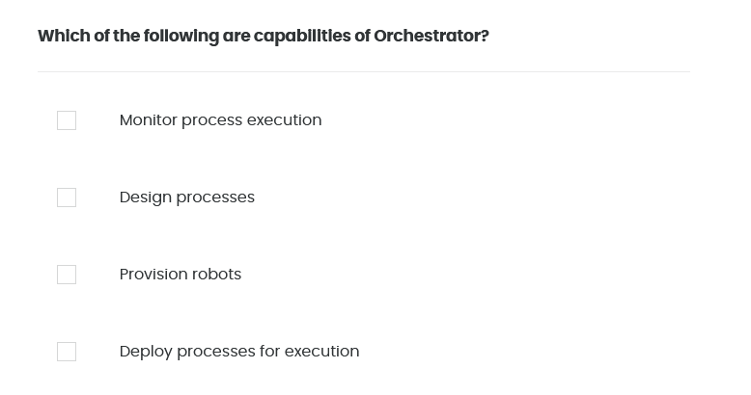
Quiz 01/10

Slide 21
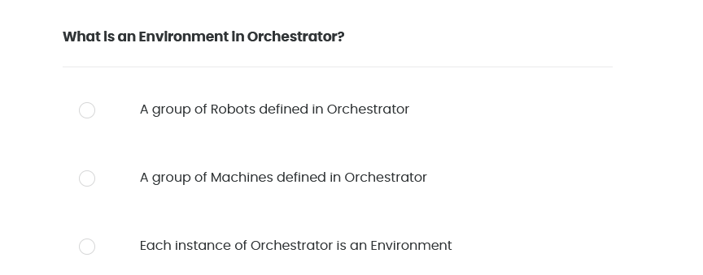
Quiz 02/10

Slide 22
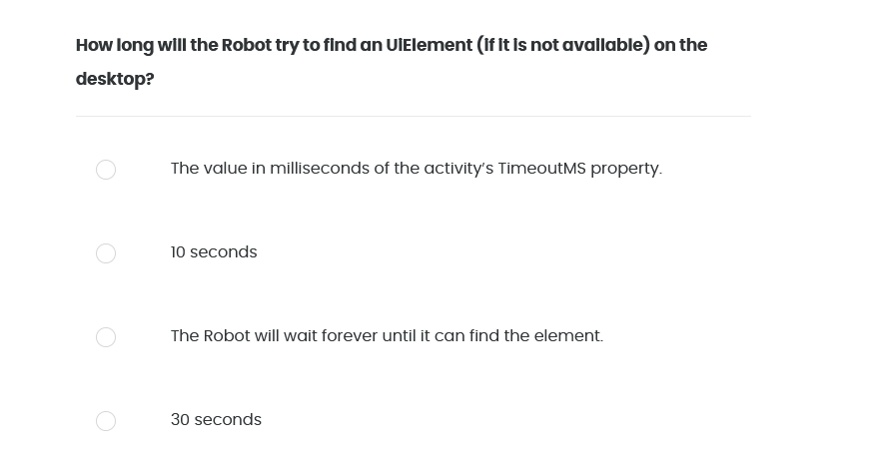
Quiz 03/10

Slide 23
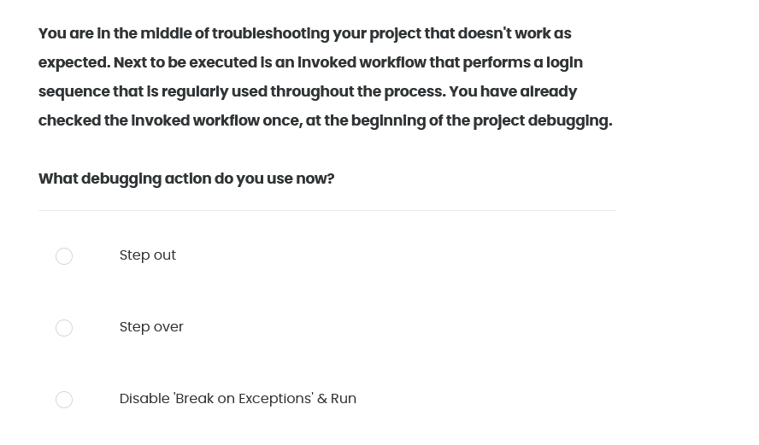
Quiz 04/10

Slide 24
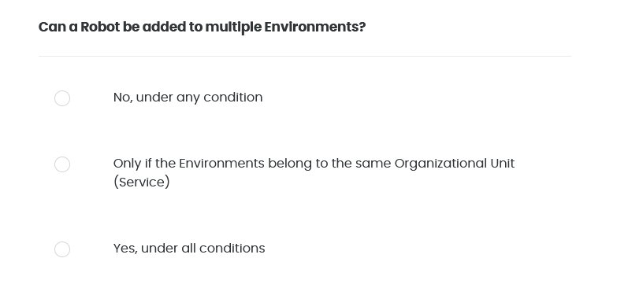
Quiz 05/10

Slide 25
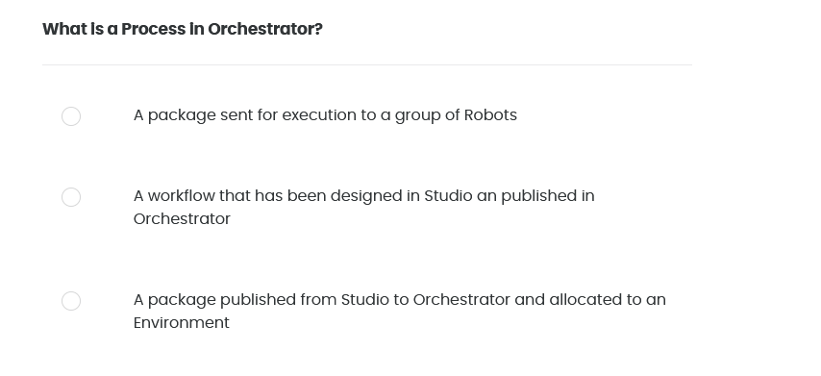
Quiz 06/10

Slide 26
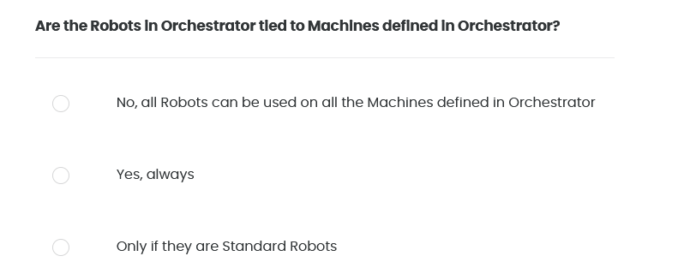
Quiz 07/10

Slide 27
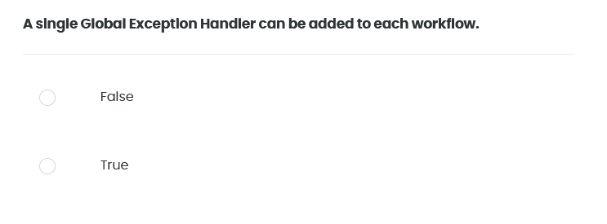
Quiz 08/10

Slide 28
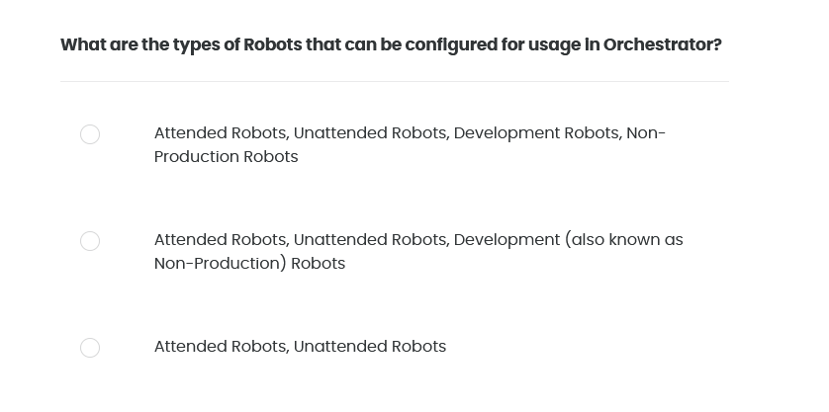
Quiz 09/10

Slide 29
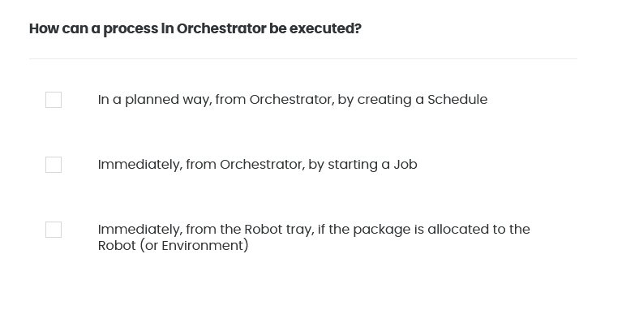
Quiz 10/10

